Slide 1



Prepaid Mobile Customer Churn Prediction
1

Slide 2
Table of Contents
1. Summary of the Data Set
2. Key Observation of the Business
3. Customer Behavior Based on the Data Set
2

Slide 3
Summary of the Data Set
Problem Statement:
In all industries, customer churn has been a real problem, and gaining new customers has been far more expensive than keeping existing ones. While there are many reasons for customer churn, dissatisfaction with services, subscriptions that are costly, and better alternatives are some of the most common. Thus, in our analysis of pre-paid phone customers, the reasons for churning are addressed and factors affecting the churn are examined for their impact.
The Customer Churn dataset is a record of the pre-paid phone customer usage over a span of three months from June to August 2013 and a list of customers that did/didn’t drop the service in September of that year.
'Churn' is the target variable that indicates whether the customer retained the service or not in September 2013.
The data set had 193 columns and 1,82,343 rows.
After preprocessing, the dataset has 71 columns and 66,469 rows.
3

Slide 4
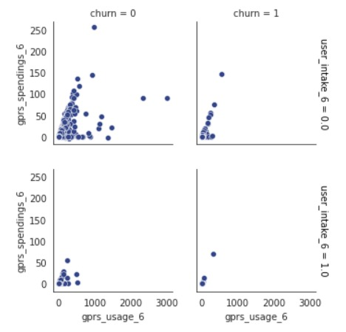
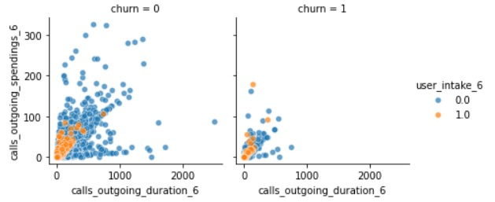
Key Observation of the Business
1. We plotted the graphs between user_intake, gprs usage, gprs spendings for all months, and churn.
The observations:
For months 6 and 7, for the old customers and those who are staying back, the spending is increasing with their usage of data for most of the customers. While for month 8, most of their spending was not increasing and they were constant.
For old customers and for those who left, there is an increase in spending on data with a small increase in the usage of the data.
2. We plotted the graphs between the amount spent on outgoing calls and the duration of all outgoing calls.
The observations:
In month 6, we can see that old customers' spending is increasing with their call durations increasing. However, some customers' spending rapidly increases with a small increase in the call duration.
In the case of new customers, the spending increases for all of them as the call duration increases.
4

Slide 5
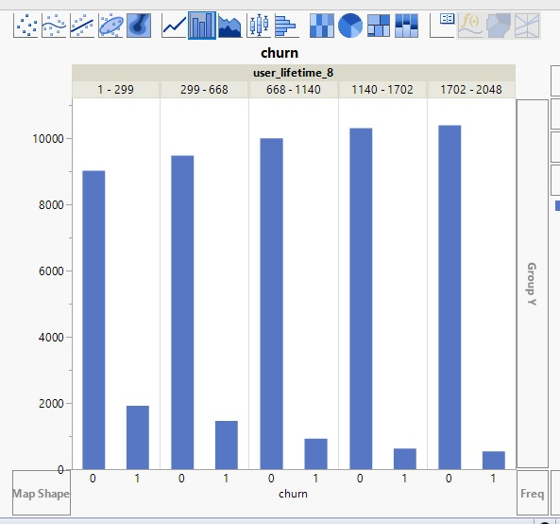
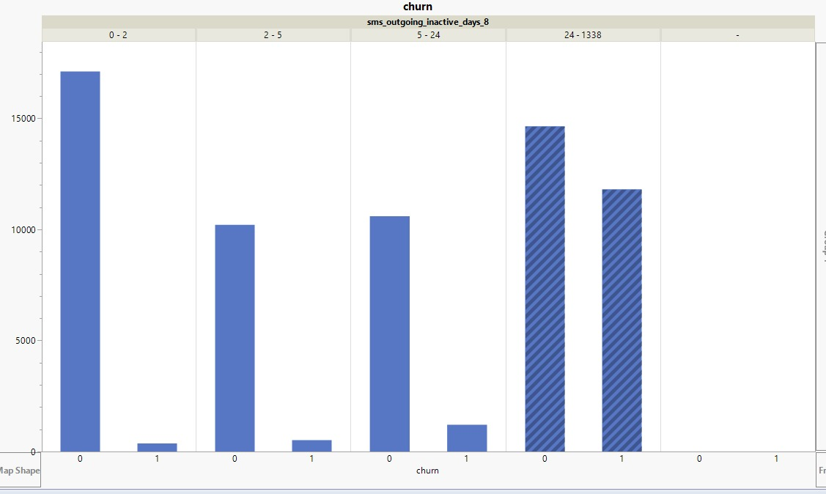
Customer Behavior Based on the Data Set
1. New users are more likely to leave the service when compared to old customers.
2. When we are predicting customer retention for a month, we could see that if the SMS outgoing inactivity days is more than 24, then there is a high chance that the customer might leave the service.
Recommendation: To retain the existing customers, the service providers should start pre-paid plans with unlimited calls and SMS, including a data plan up to a limit of certain KBs of usage, beyond which they will be charged extra. This will also bring in new customers and reduce the inactivity of the customers.
5

Slide 6

Thank You
6

